Slide 1
Installation Guide
(Eclipse Plug-in － Subclipse)
2008. 12. 09
CODELABOR
Shin Sang Jae (codelabor@gmail.com)

Slide 2
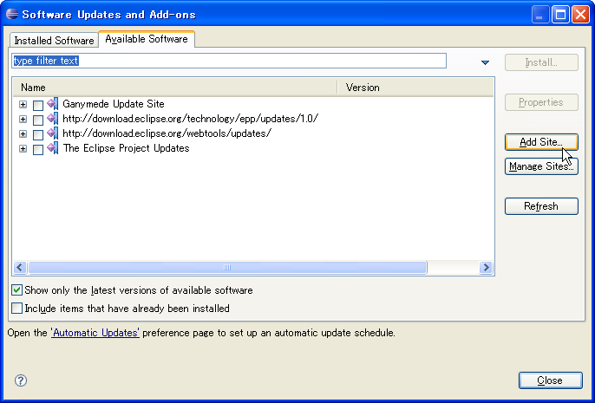
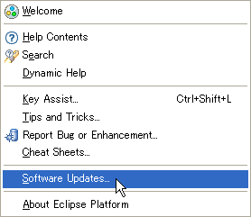
Eclipse Plug-in
Update
Eclipse Team Provider plug-in providing support for Subversion within the Eclipse IDE
Officical Site: http://subclipse.tigris.org/
Eclipse update site URL: http://subclipse.tigris.org/update_1.4.x

Slide 3
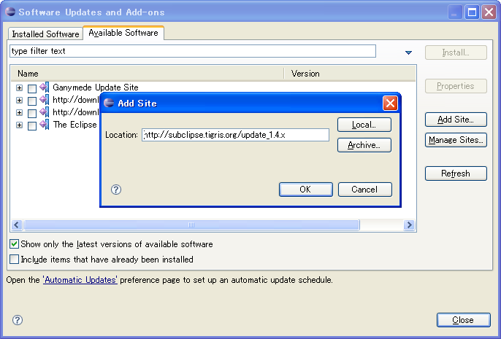
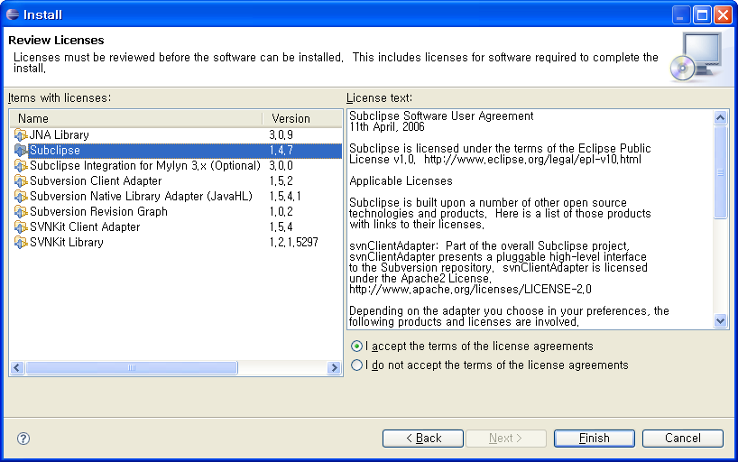
Eclipse Plug-in
Add Site
Site Location: http://subclipse.tigris.org/update_1.4.x

Slide 4
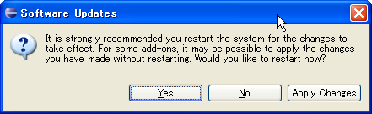
Eclipse Plug-in
Preference
Restart Eclipse or Apply Changes

